Slide 1
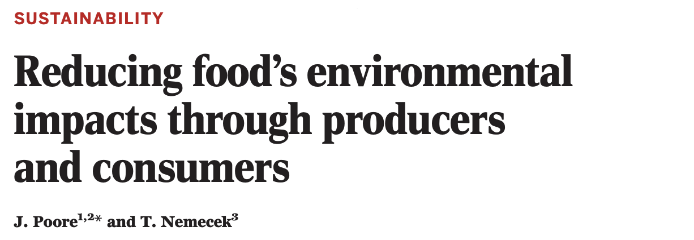


Journal club
45 minutes to read
5-10 minutes to present
What does the paper speak about and why does it matter ?
Methodology
Main results
Conclusion

Slide 2
Focus on Fig.S1, Fig.1/Fig.S3, Fig.2A-B, Fig.S6
Focus on Table 1, Panel 2, Fig.1 & Table 6 and include Title picture from the ‘EAT-Lancet Commission Brief for Everyone’
Focus on Fig. 1, Fig.4, and Fig.3/S2, andput in perspective (Ch & Woréldwide) using Table 8 of the report from Postulate 19.3639 (Bourgeois) of the Swiss Parliament, and the following data :
average cattle head/ha = 1.7 (CH), 0.7 (EU)

Slide 4
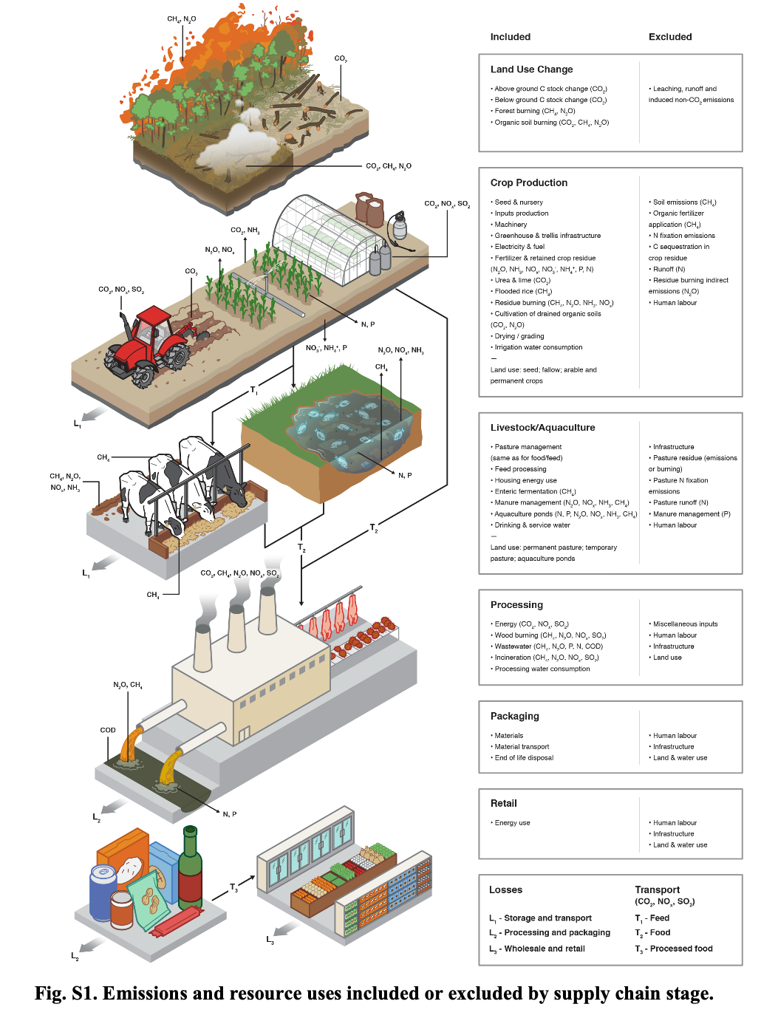
Fig. S1

Slide 5
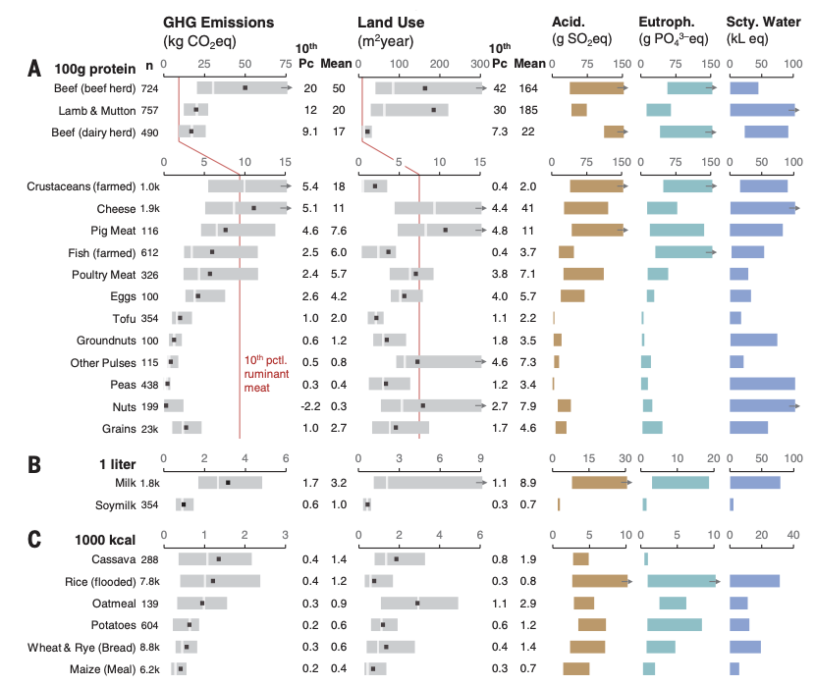
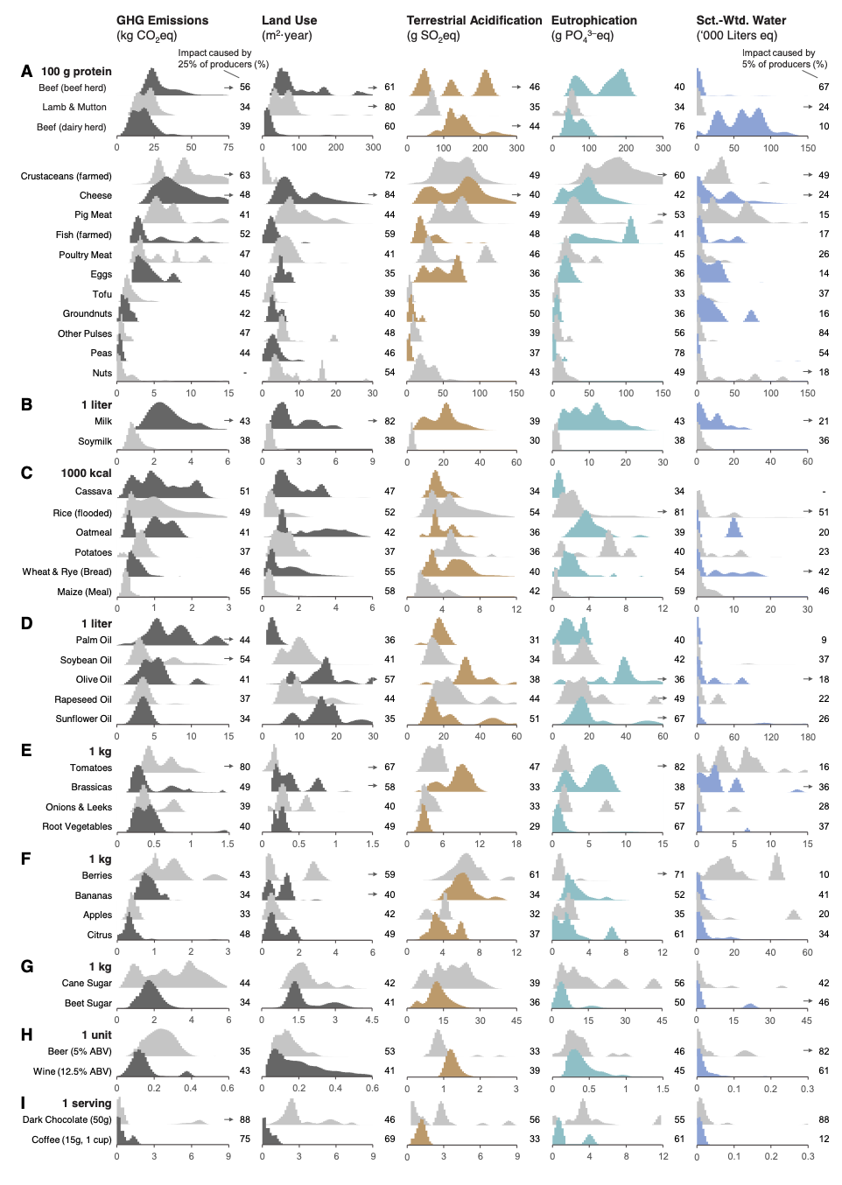
Fig. 1/S3

Slide 6
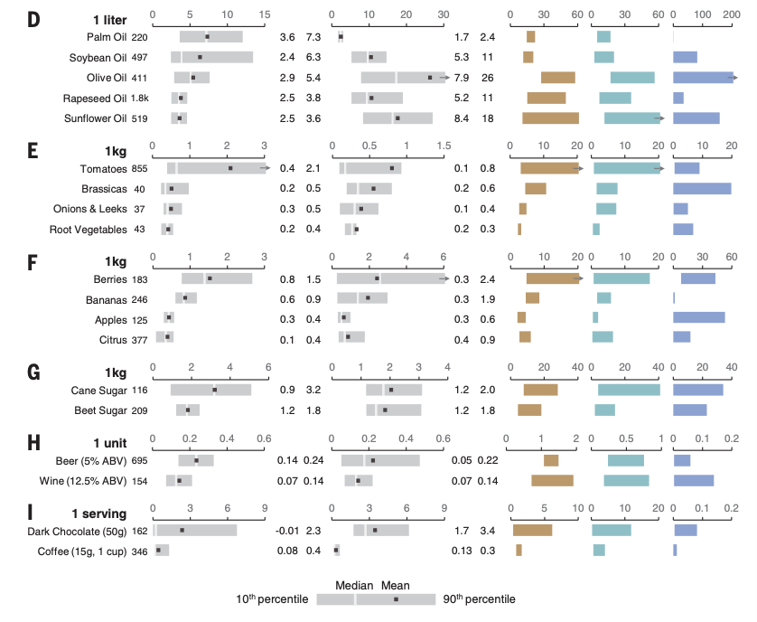
Fig. 1/S3

Slide 7
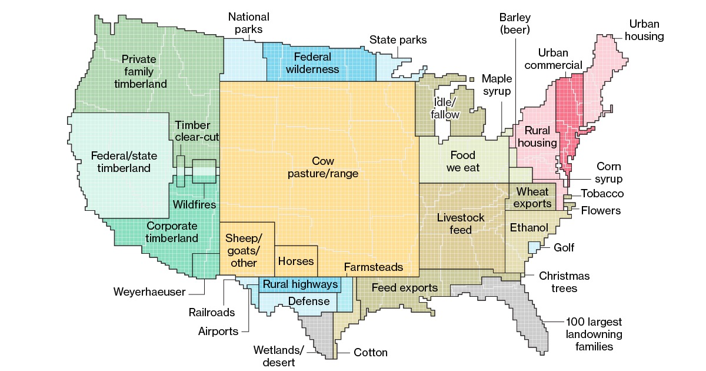
But GHG emissions are not the only problem
Land use
Merril D. & Leatherby L., «Here’s how America Uses Its Land», Bloomberg, 13.07.2018

Slide 8
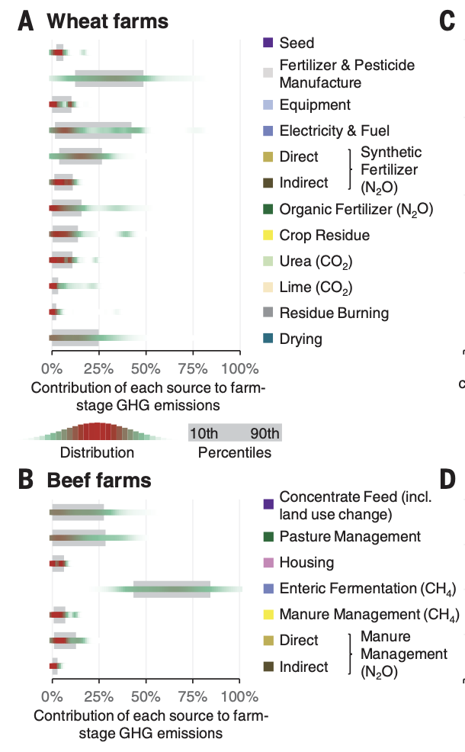
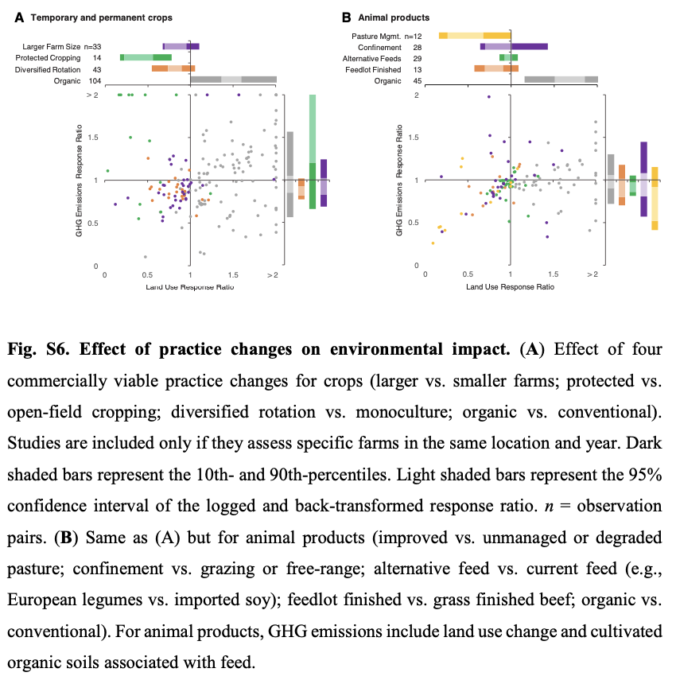
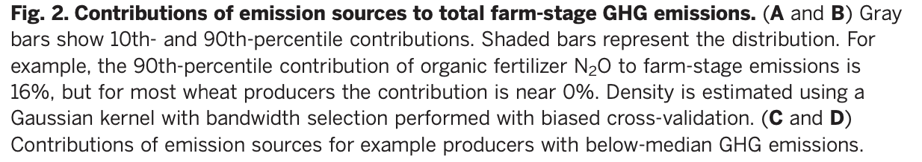

Slide 9
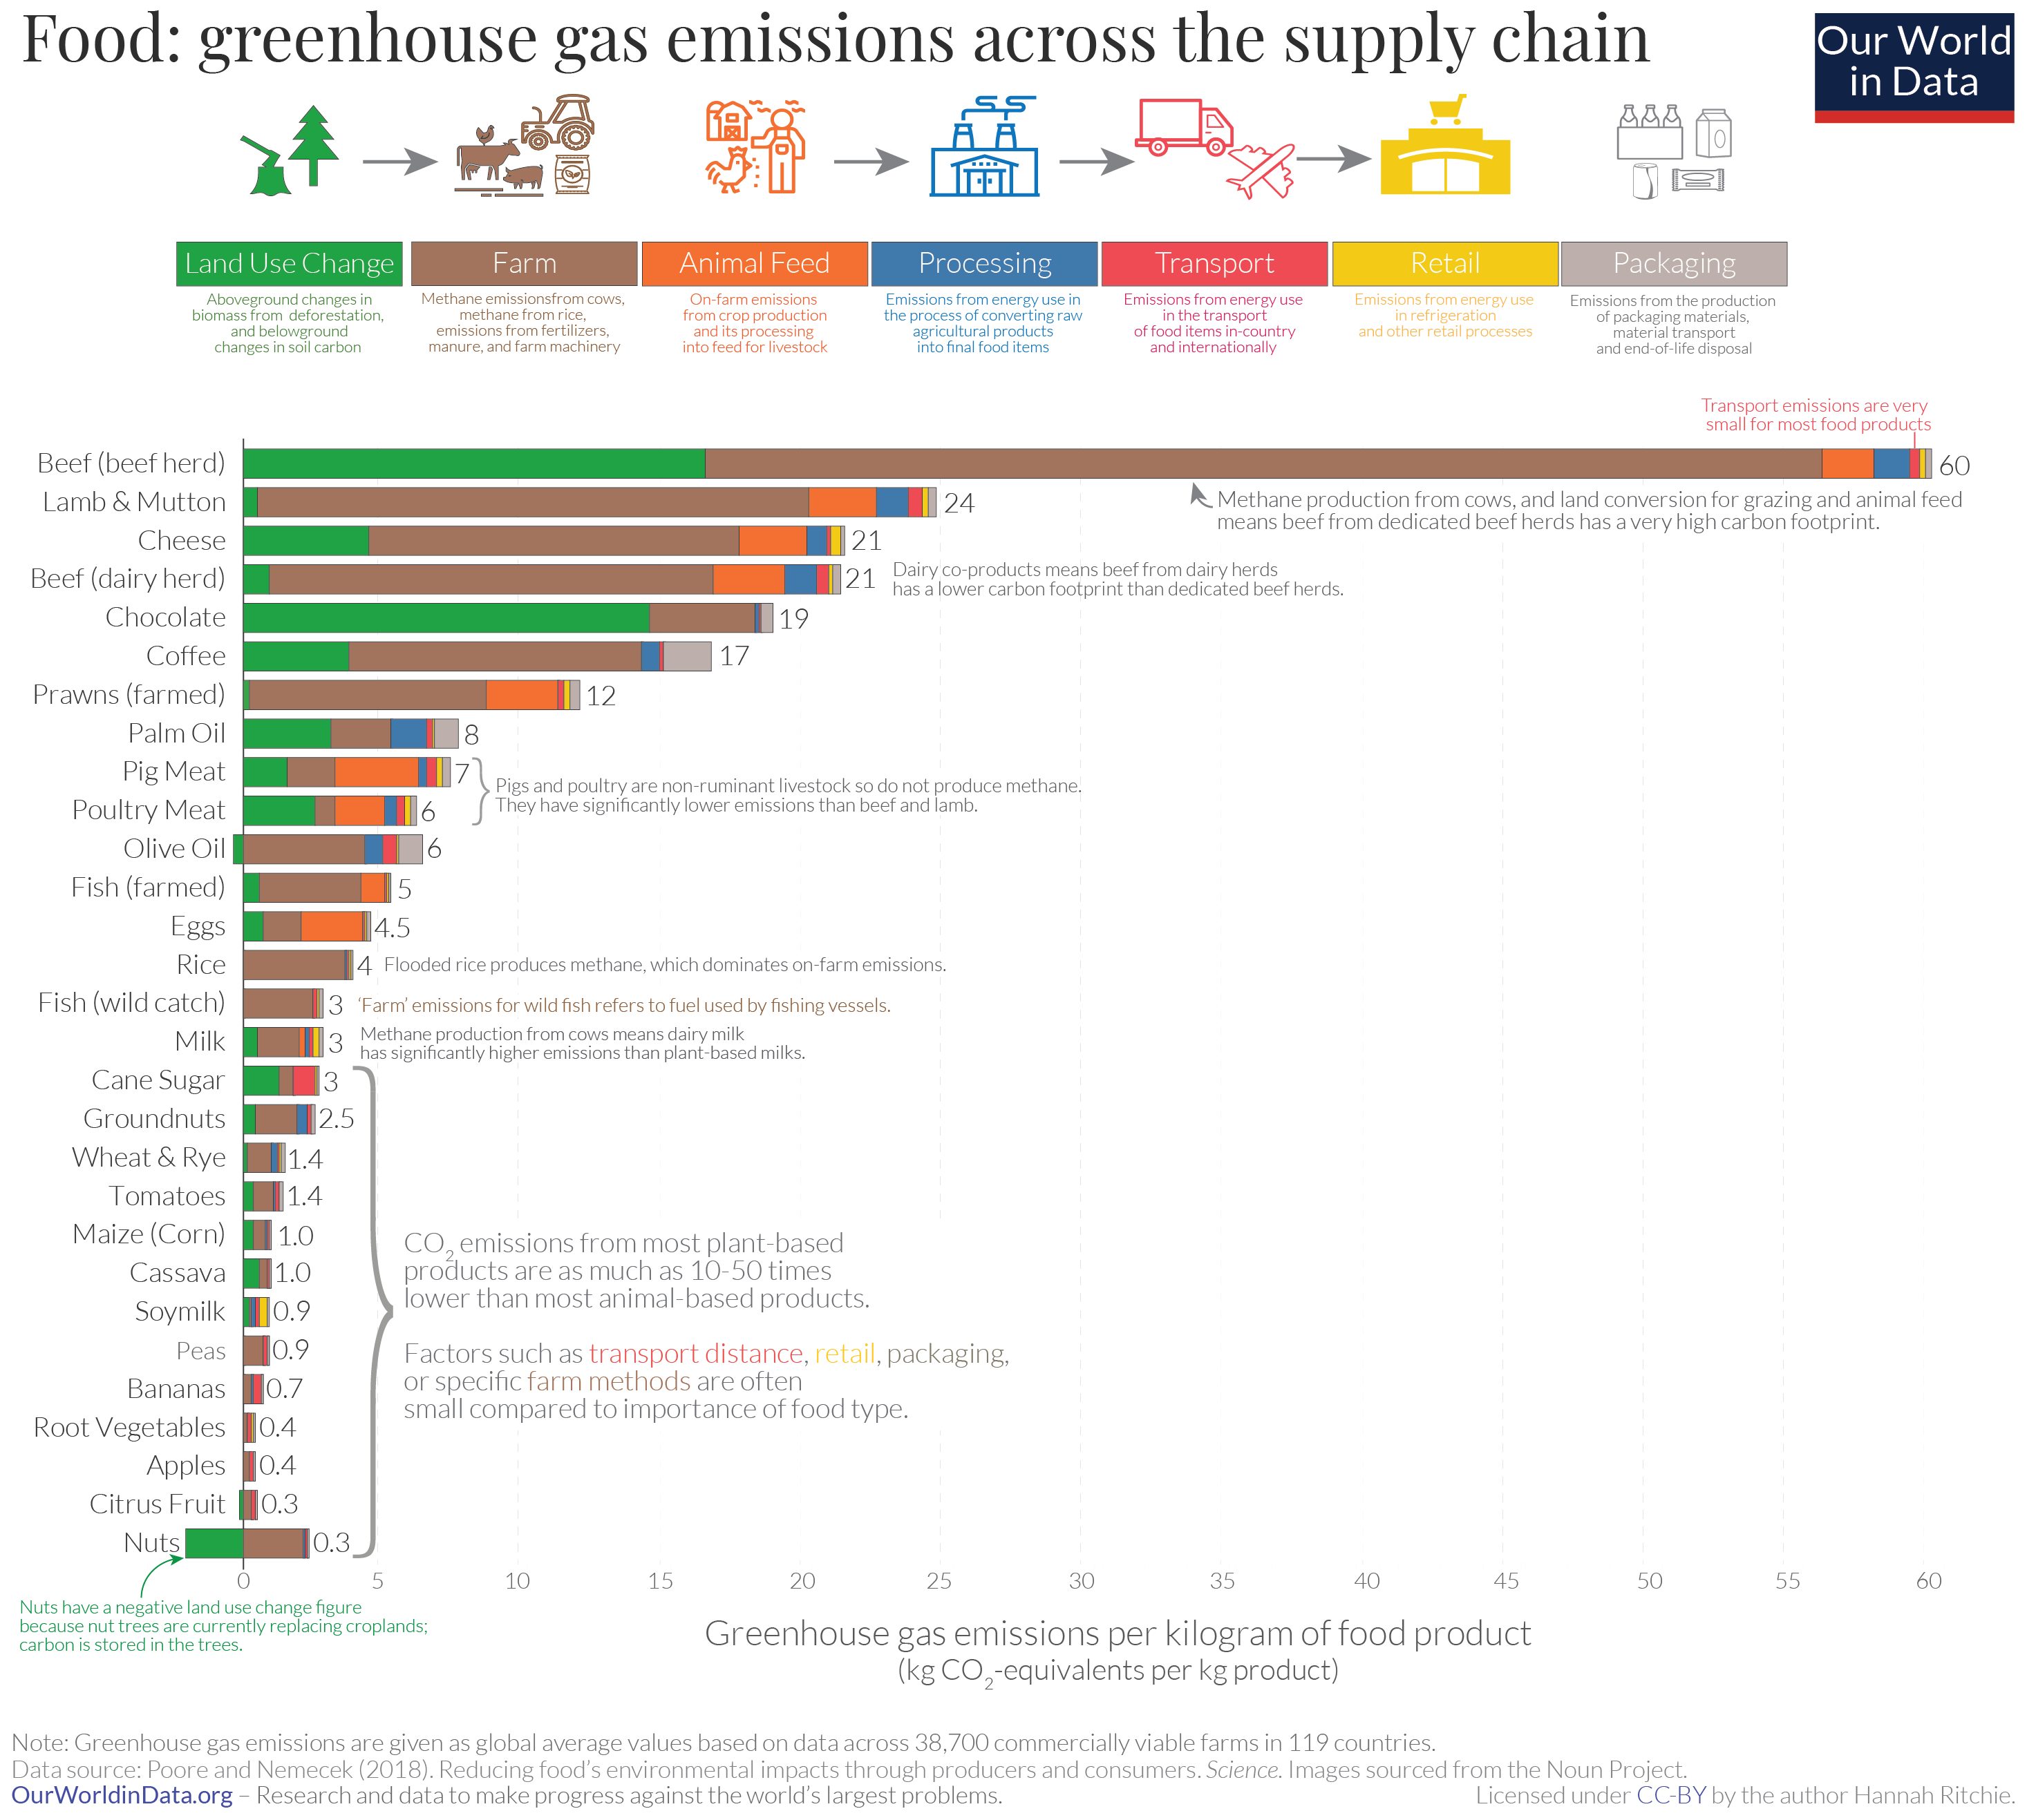

Slide 11
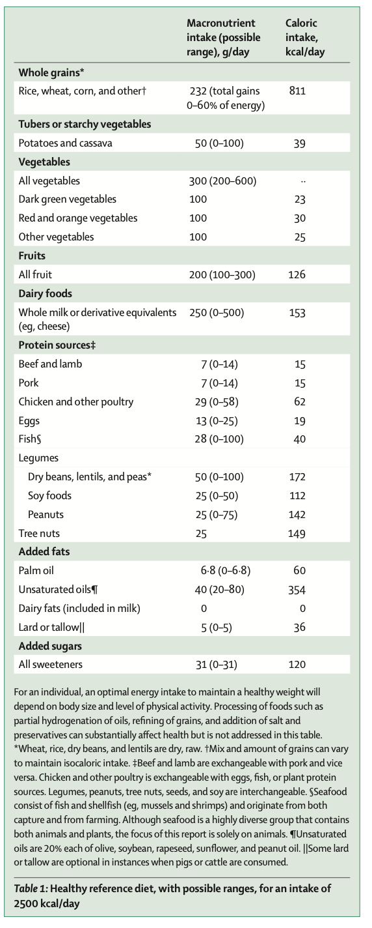
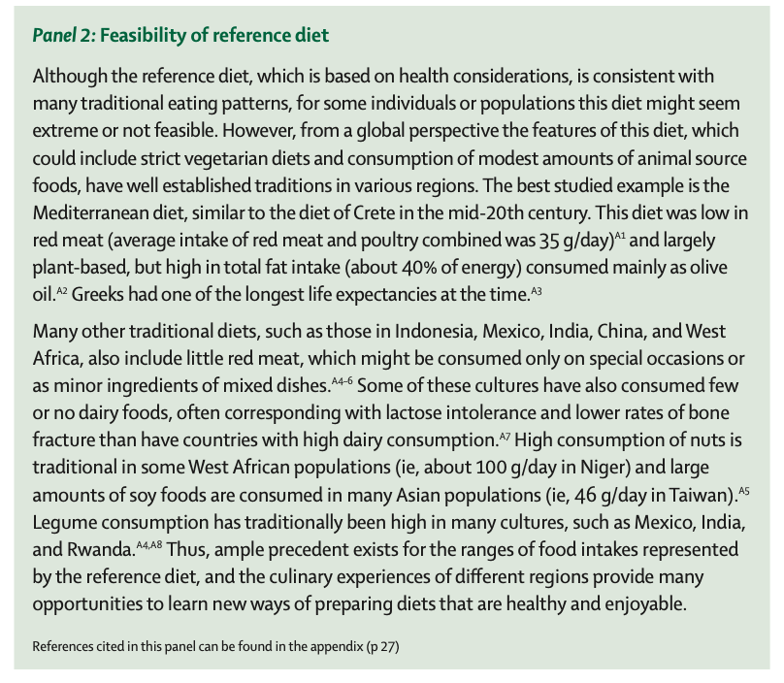

Slide 12
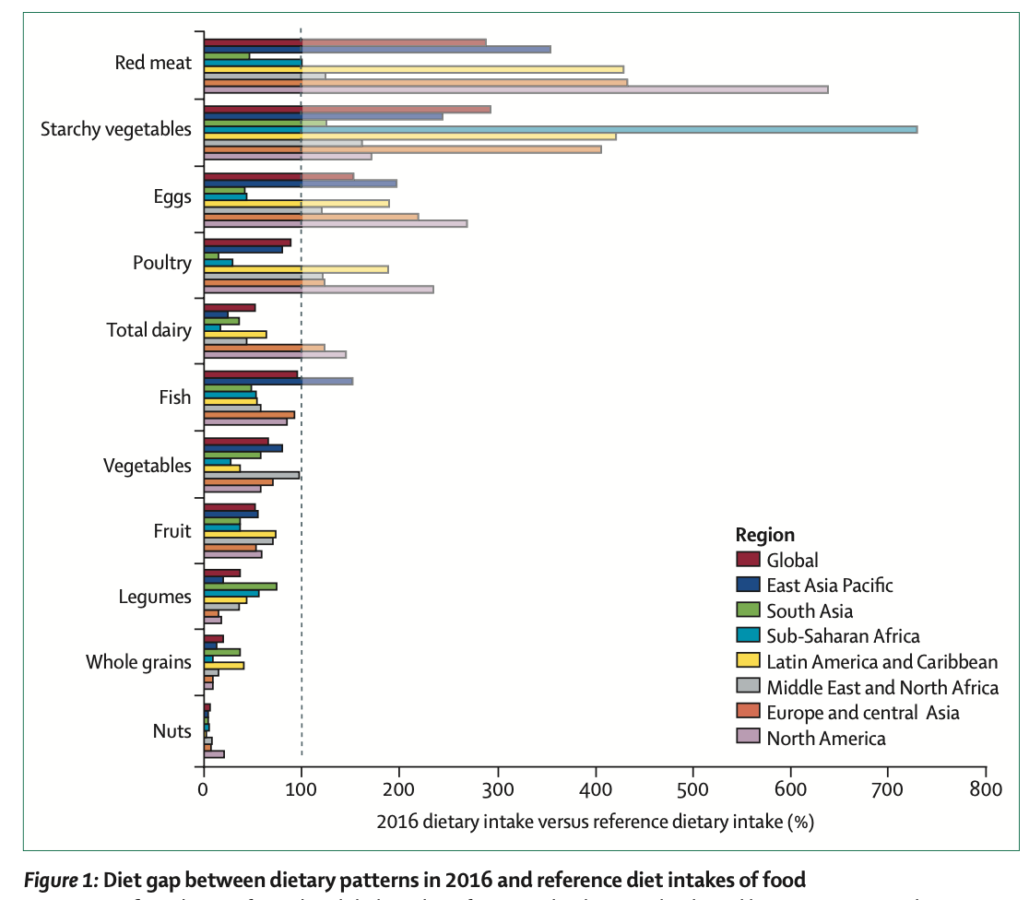

Slide 13
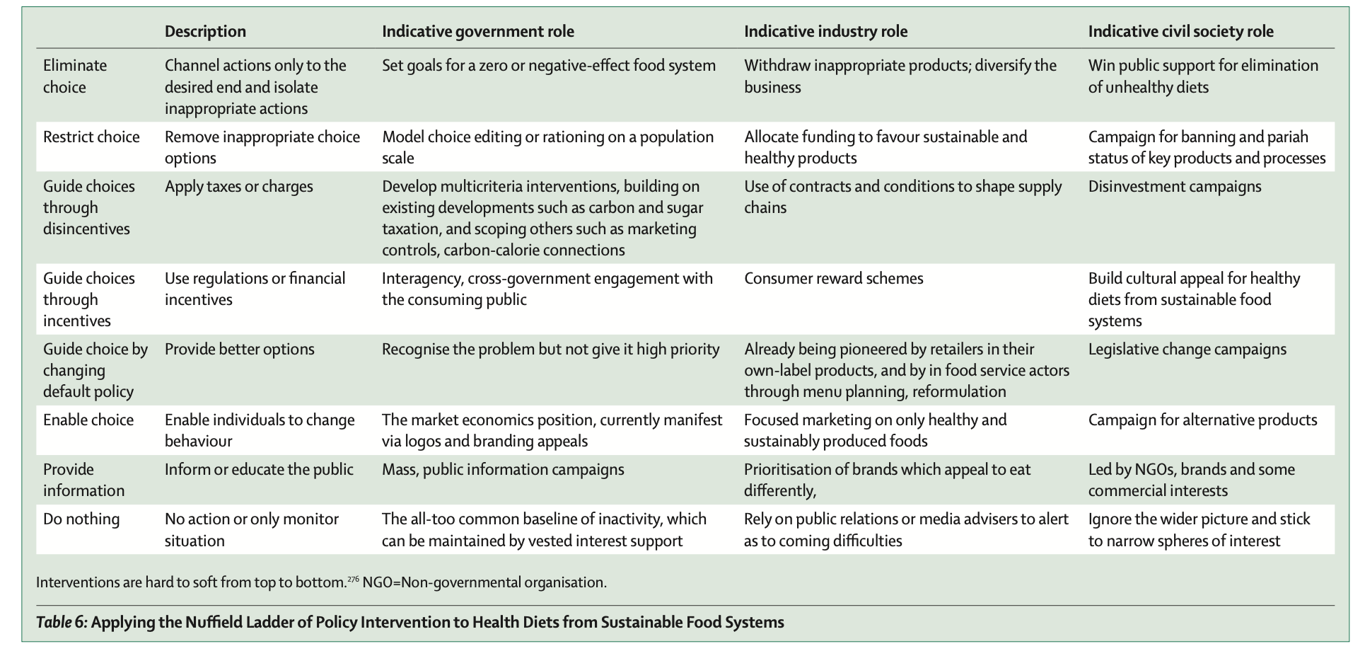

Slide 14


Slide 16
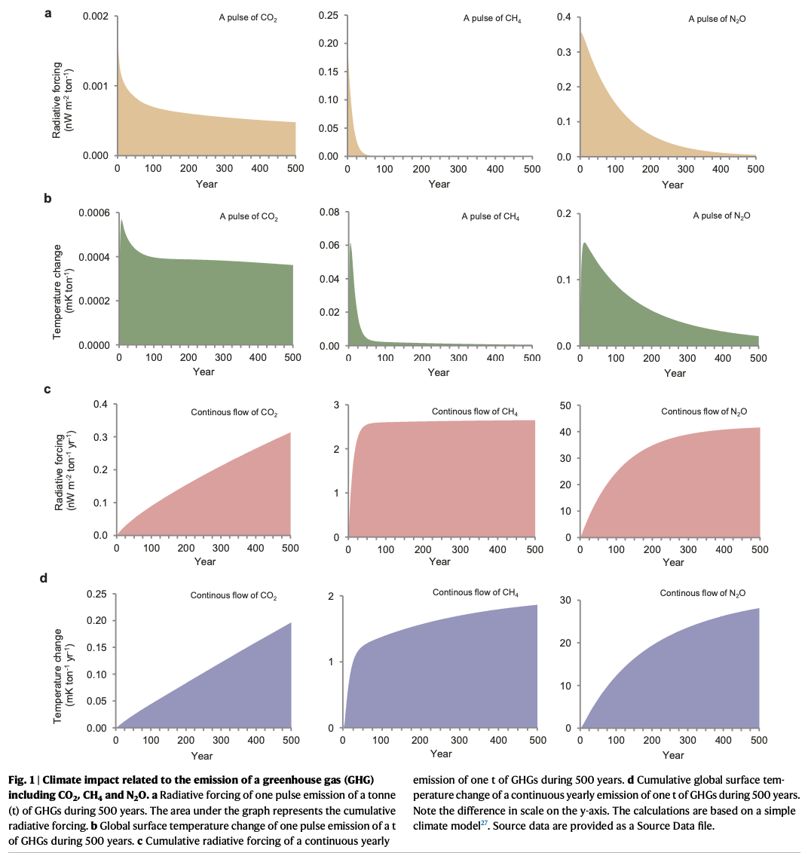

Slide 17
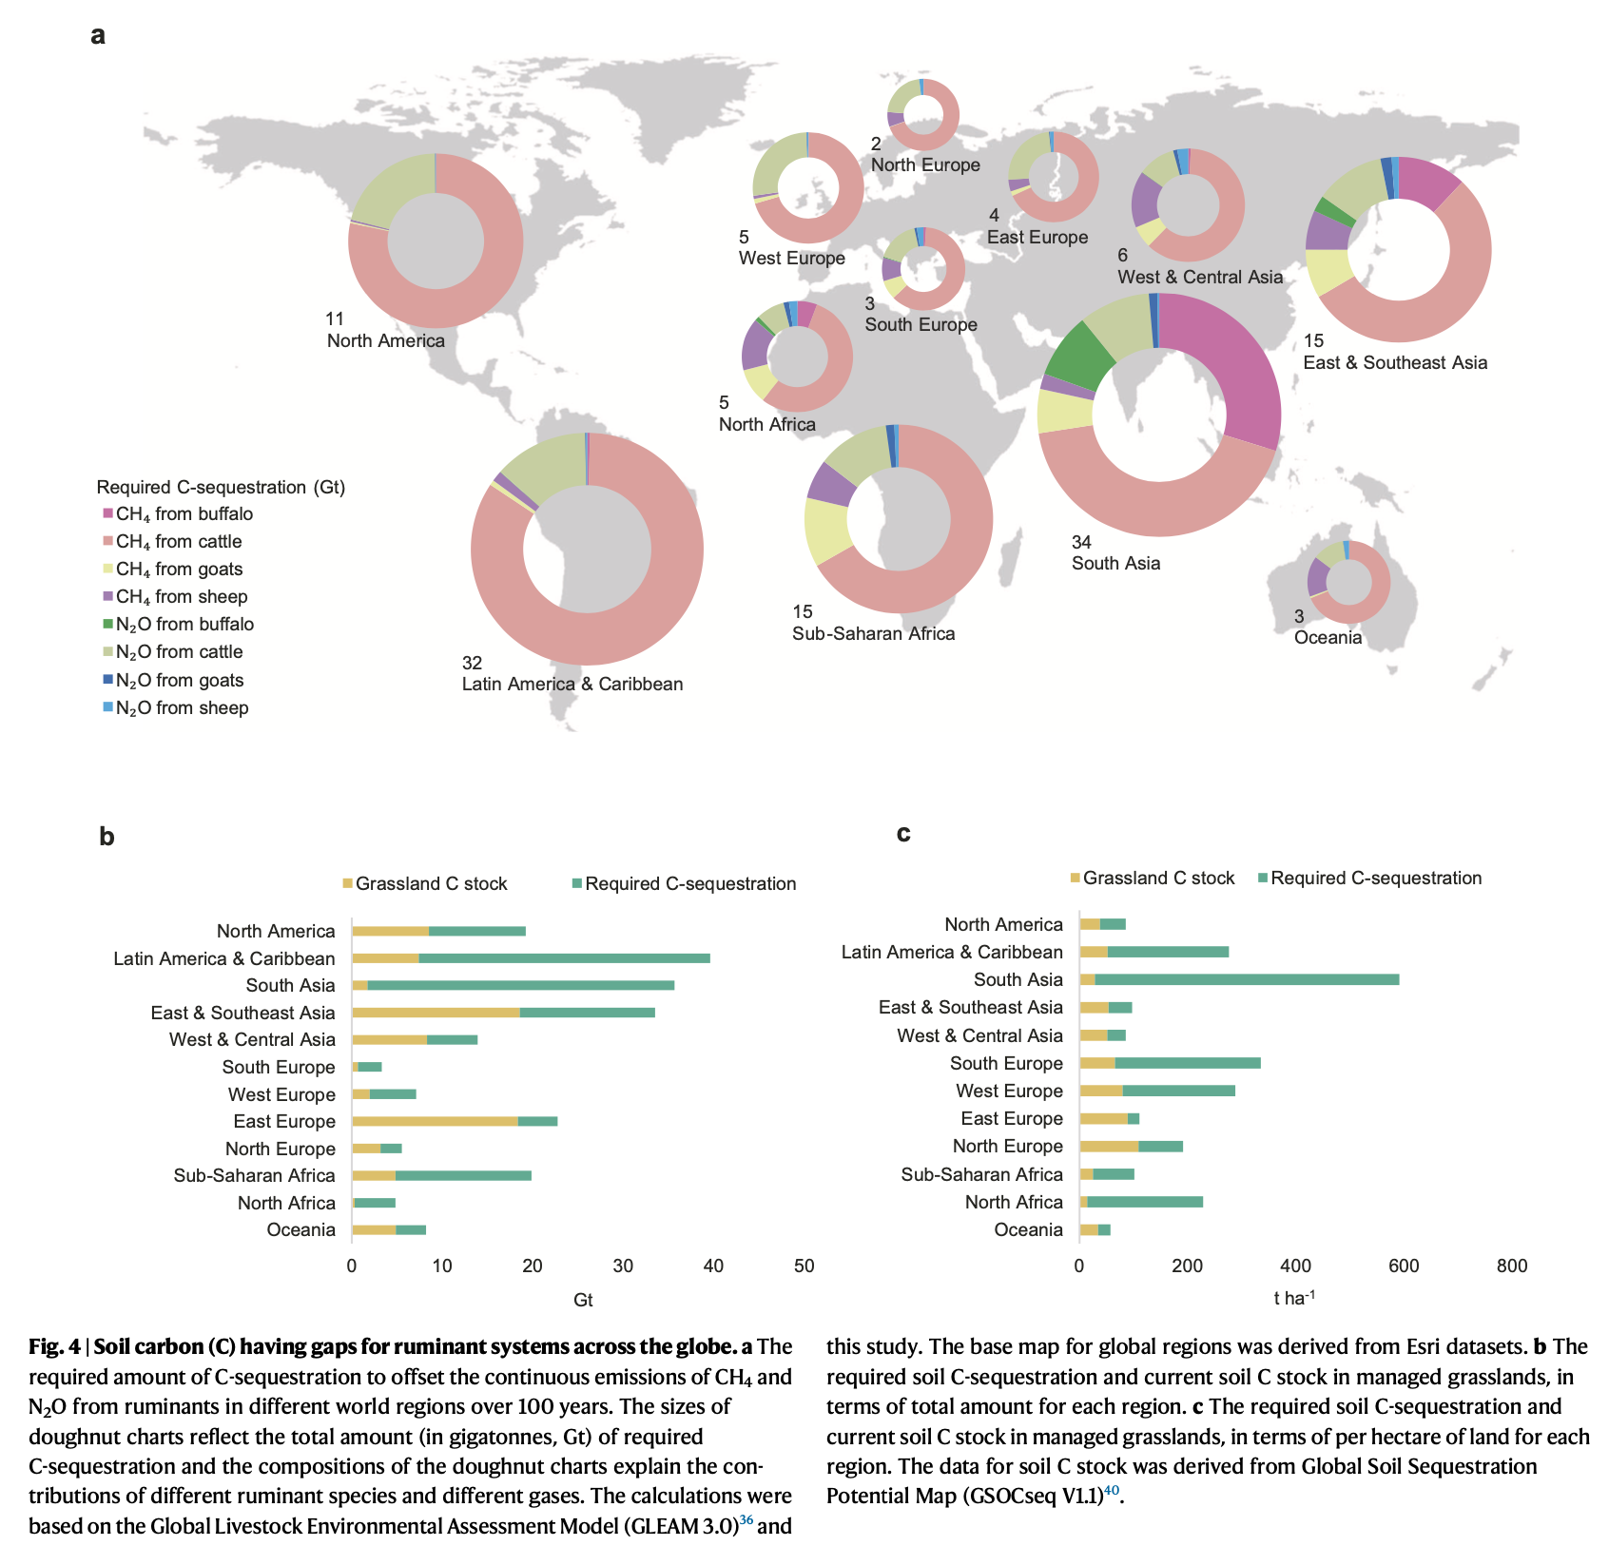

Slide 18
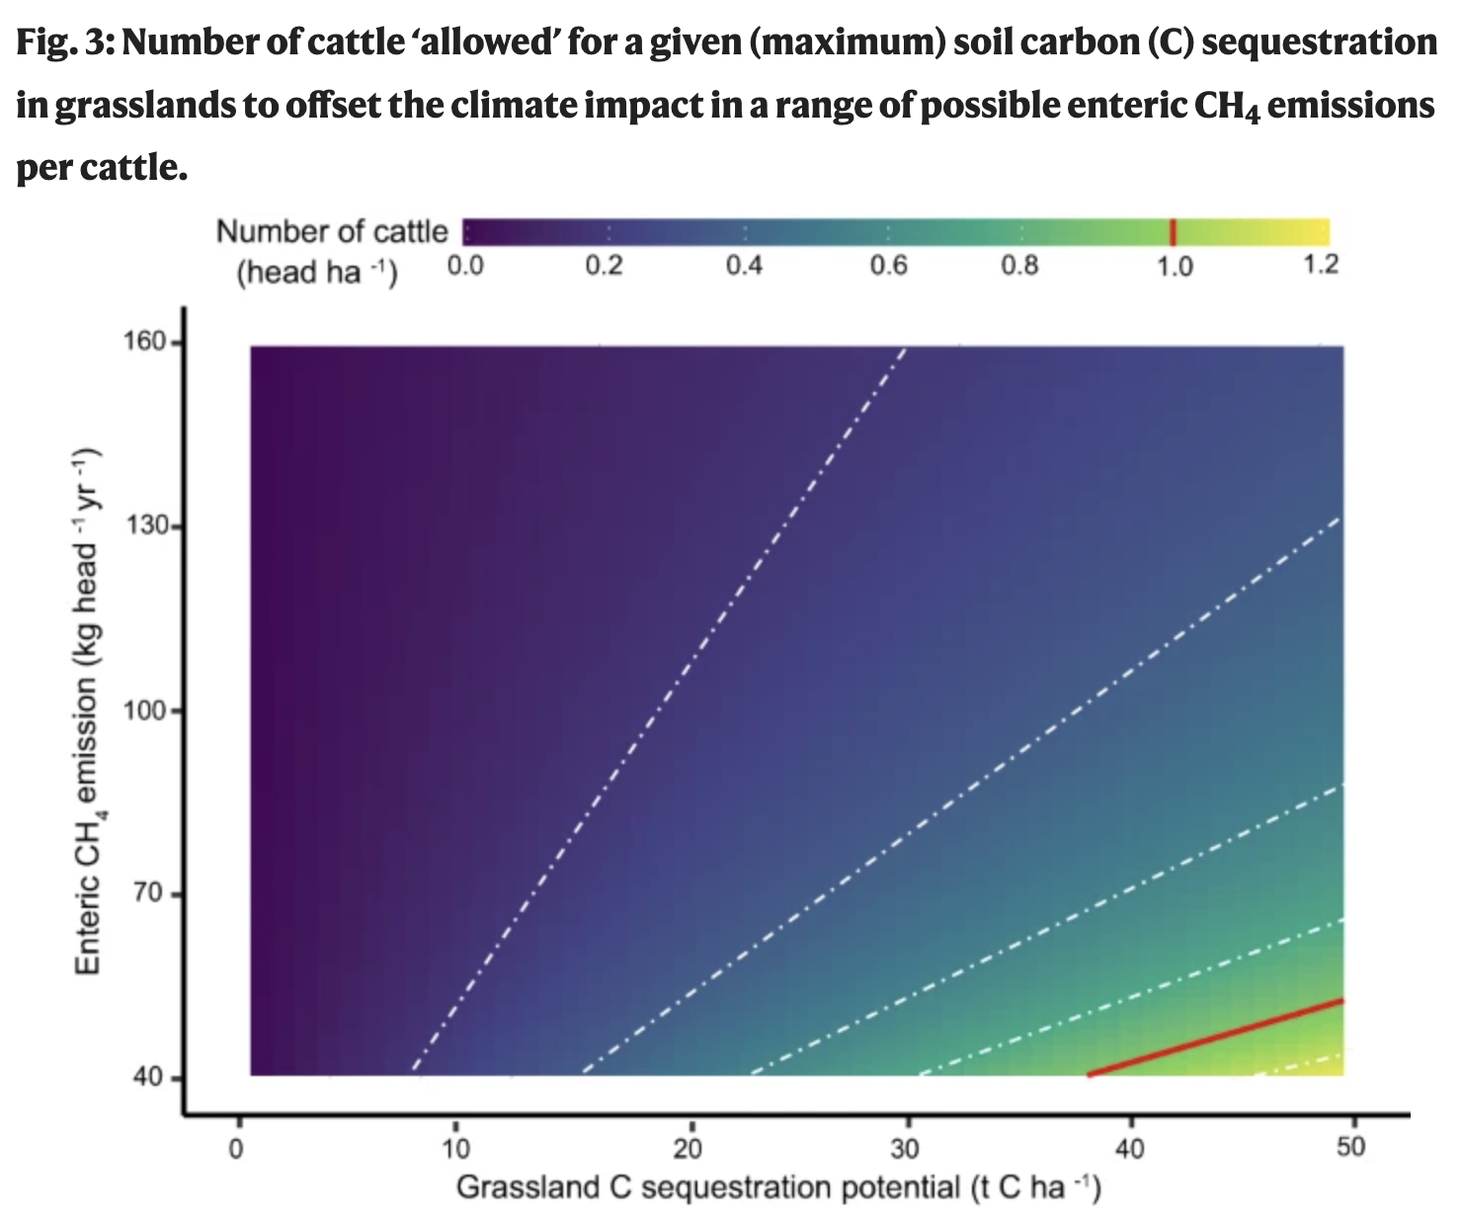
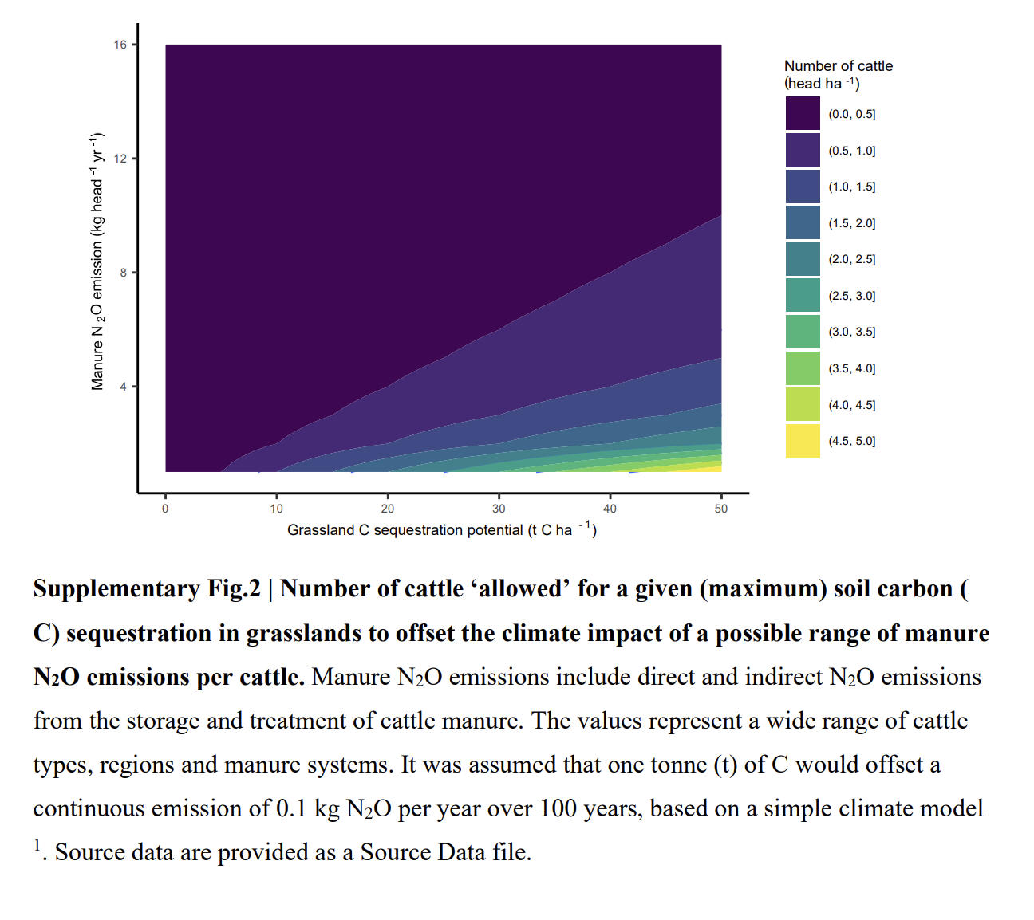

Slide 19

